Slide 1
A Comparative Analysis On Instruction Detection From Text
Faculty of Science and Technology, Dept. of Computer Science
Undergraduate Thesis
Student Name | ID | Contribution
1. Abdur Rahman Emon | 18-36603-1 | 25%
2. Md Shakibur Rahman | 18-36598-1 | 25%
3. Gazi Ehsanul Haque | 18-36572-1 | 25%
4. Nabila Akter Nowshi | 17-35635-3 | 25%
Supervisor: | TANVIR AHMED

Slide 2
Content
Introduction
The History of Natural Language Process (NLP)
Impacts of Natural Language Process
Methods
Results and Findings
Discussion
Conclusion

Slide 3
Introduction
What is ‘NLP’?
Building machines that comprehend and react to text or voice data and respond with their own text or speech, much like people do, is the goal of natural language processing (NLP)
History
After World War II, the field of natural language processing was founded. People at the time saw the value of translating between languages and sought to build a system that could perform this kind of translation automatically

Slide 4
Impacts of NLP
In Profession
Reduces the Error Margin
Highlight Pertinent Text and Extract Important Details
Continue to Harness Unstructured Data
In Health Care

Slide 5
Impacts of NLP
Day to Day Life
Presenting Unstructured Data as Detailed Information
Provides a Sentence's Potential Following Word
Depending on the Language Selected, User Remove Spelling Error, Inappropriate Language and other problems
Auto Correction in the Sentence
Email Users often Face a Lot of Spam, and NLP can help Defend from Spam
Classifies Re-published Content on Multiple Pages

Slide 6
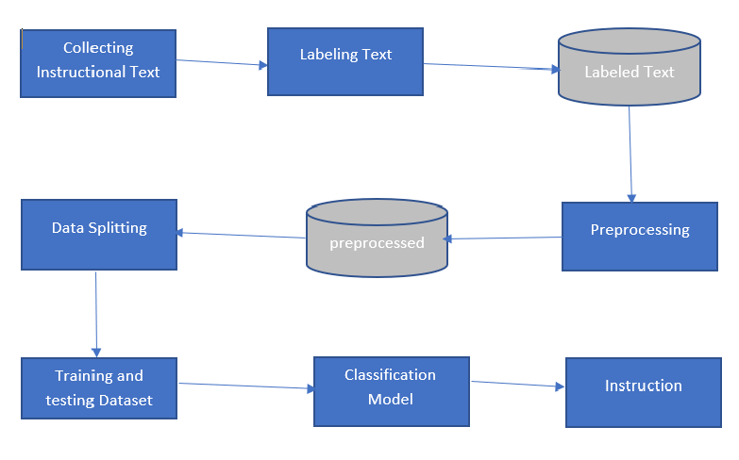
Methods
Fig: Architecture of Our System

Slide 7
Methods
What is Machine learning?
Types Of Machine Learning?
Supervised and Unsupervised learning?
Categories of Supervised and Unsupervised learning?

Slide 8
Methods
Algorithms Used
KNN (K - nearest Neighbor)
Naïve Bayes
Support Vector Machine (SVM)
Logistic Regression

Slide 9
Methods
KNN( K - Nearest Neighbors)
Domain : Machine Learning
Accuracy : 53%
2. Naïve Bayes
Domain : Machine Learning
Accuracy : 69%

Slide 10
Methods
3. Support Vector Machine (SVM)
Domain : Machine Learning
Accuracy : 57%
4. Logistic Regression
Domain : Machine Learning
Accuracy : 76%

Slide 11
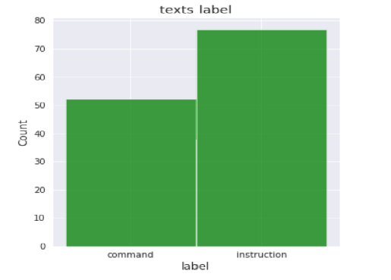
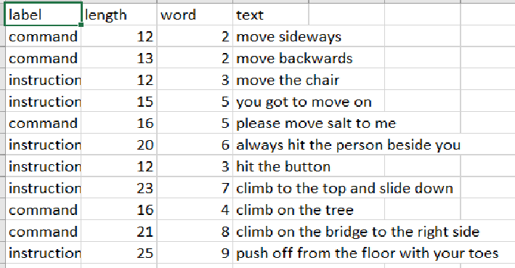
Results and Findings
Dataset

Slide 12
Results and Findings
Accuracy of Models
Models | Accuracy
KNN | 53%
Naïve Bayes | 69%
SVM | 57%
Logistic Regression | 76%

Slide 13
Discussion
Dataset Limitation
Accuracy Differences
Methods Testings
Machine Lackings

Slide 14
Conclusion
Successfully implemented the proposed strategy
An AI-based solution can be developed
Future research can be explored with more algorithmic method for better accuracy .

Slide 15
Thank You

